Slide 1
Social Media’s perception of
Small Businesses
JAN 2022 - MAY 2022
Davidson Siga and Rajanikant Tenguria
MISM, CMU
Mentored by
Gabriela Gongora-Svartzman, Ph.D.
Assistant Teaching Professor, CMU

Slide 2
Motivation
Where do we get the Data?
Data Cleaning and Transformation
Technical Challenges
Sentiment Analysis
Exploratory Data Analysis
Results
Conclusion
Next Steps

Slide 3
Motivation
Covid-19 disrupts the world
Covid-19 disrupts Small businesses
Question we’re trying to answer through Social Media

Slide 4
Covid-19 disrupts the world
An Additional 71 million people are pushed into Extreme Poverty in 2020^{[1]}
due to COVID-19
[1] : UN.ORG : https://www.un.org/sustainabledevelopment/wp-content/uploads/2019/07/E_Infographic_01.pdf

Slide 5
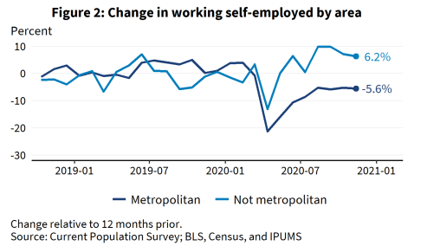
Covid-19 disrupts Small businesses
Self employment has steeply increased in covid times.
Location makes a difference in the decision making of SMB owners[2]
[2] : https://cdn.advocacy.sba.gov/wp-content/uploads/2021/03/02112318/COVID-19-Impact-On-Small-Business.pdf

Slide 6




Question we’re trying to answer through Social Media
Have people started supporting small businesses differently due to covid?
Does location play a role in this support?

Slide 7
Motivation
Where do we get the Data?
Data Cleaning and Transformation
Technical Challenges
Sentiment Analysis
Exploratory Data Analysis
Results
Conclusion
Next Steps

Slide 8

Where do we get the Data?
Twitter & API Pull
Keywords and Hashtag selections

Slide 9
Twitter & API Pull
We have pulled 10k original and unique tweets
Immediate future work : scale results to a million tweets
We used the tweepy to pull tweets
Use of Twitter Research API Access
No retweets were pulled from Twitter so as to have unique tweets

Slide 10
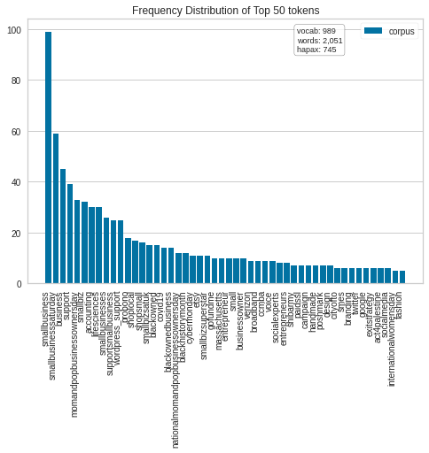
Keywords and Hashtag selections
Initially we got some tweets and extracted hashtags from these tweets.
These hashtags were later chosen based on the frequency and context count

Slide 11
Motivation
Where do we get the Data?
Data Cleaning and Transformation
Technical Challenges
Sentiment Analysis
Exploratory Data Analysis
Results
Conclusion
Next Steps

Slide 12
Data Cleaning and Transformation
Data Cleaning Process Flow
Location Cleaning Approach
Final Dataset for Analysis

Slide 13
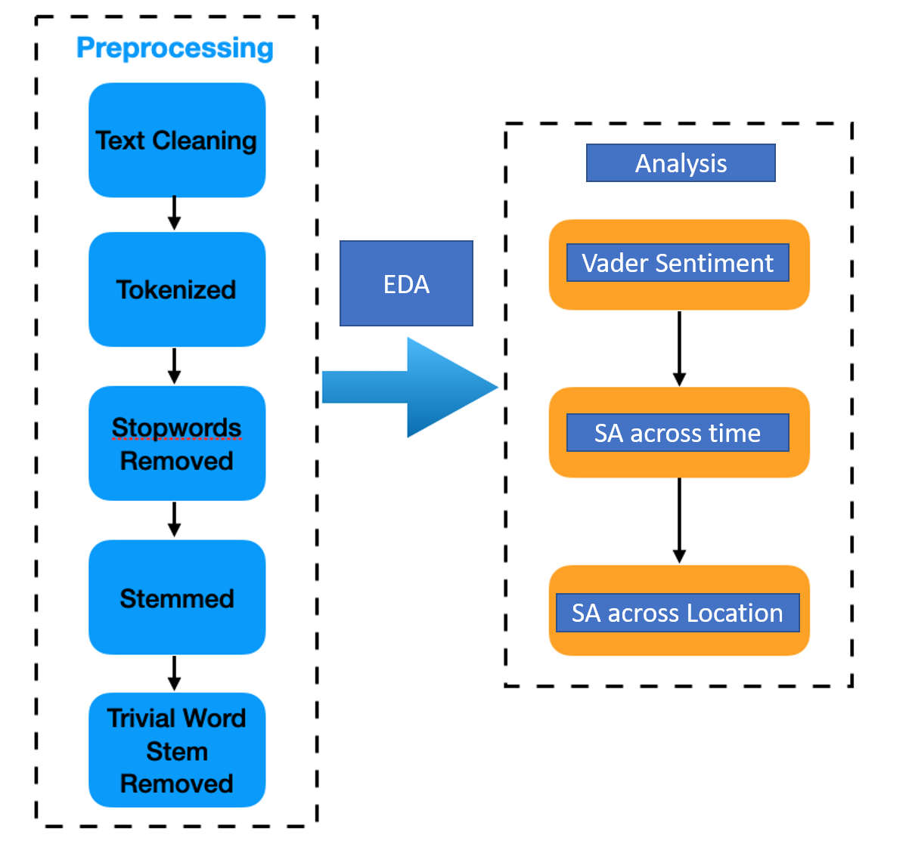
Data Cleaning Process Flow
EDA: Exploratory Data Analysis
SA : Sentiment Analysis
[3] : https://towardsdatascience.com/how-to-build-a-real-time-twitter-analysis-using-big-data-tools-dd2240946e64

Slide 14
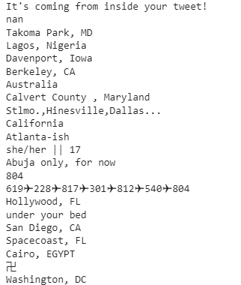
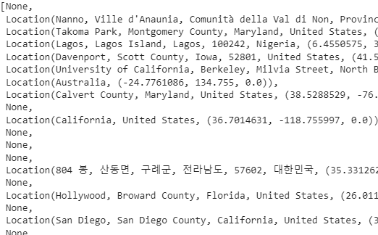
Location Cleaning Approach
Use of GeoTag to clean the location tag.
Challenging task on big data, needs alternative approaches
Original Data
GeoTag Outputs

Slide 15
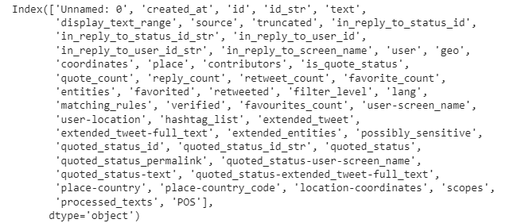
Final Dataset for Analysis
Information ranging from User’s Aggregated information
to
Tweet specific information were a part of the pull
We’re interested in processes_texts (an outcome of our Data Cleaning)

Slide 16
Motivation
Where do we get the Data?
Data Cleaning and Transformation
Technical Challenges
Sentiment Analysis
Exploratory Data Analysis
Results
Conclusion
Next Steps

Slide 17
Technical Challenges
QA Log

Slide 18
QA Document Gist
Data Scarcity - not many people talk about the topic
Data pull - continuous blocking by Twitter
Location cleaning and grouping for better and consolidated results is essential
Detailed QA Log available here : https://docs.google.com/document/d/1fmC44xrybJrGUIL1wYVpO_tBWvqt3psnVFlLJ8Og7hY/edit?usp=sharing

Slide 19
Motivation
Where do we get the Data?
Data Cleaning and Transformation
Technical Challenges
Sentiment Analysis
Exploratory Data Analysis
Results
Conclusion
Next Steps

Slide 20
Sentiment Analysis
What is Sentiment Analysis?
Vader Sentiment Analyzer

Slide 21
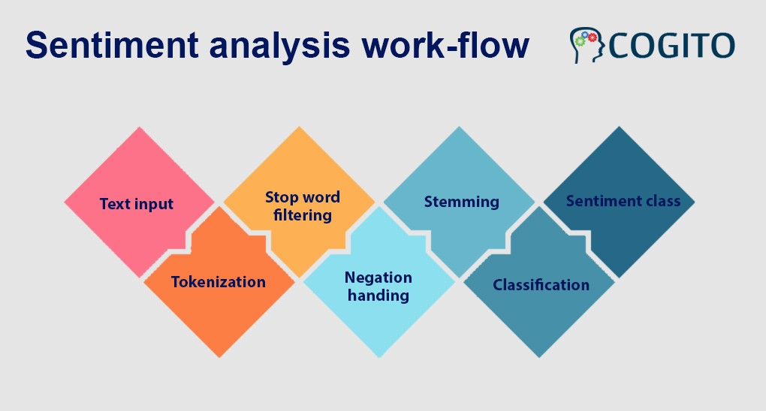
What is Sentiment Analysis?
The background of what typically happens in a sentiment analyzer
[3] : https://cogitotech.medium.com/sentiment-analysis-how-it-works-types-everything-you-need-to-know-822a1f2ddeaf

Slide 22

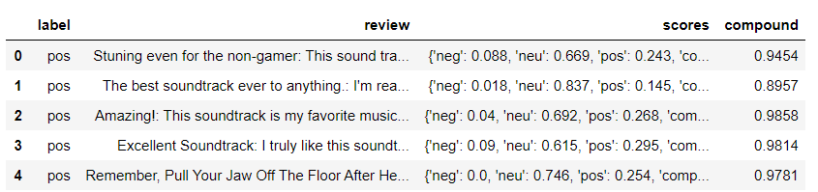
Vader Sentiment Analyzer
We extracted tweet sentiments of people talking on twitter
This was performed using Vader.
[4] : https://towardsdatascience.com/sentimental-analysis-using-vader-a3415fef7664

Slide 23
Motivation
Where do we get the Data?
Data Cleaning and Transformation
Technical Challenges
Sentiment Analysis
Exploratory Data Analysis
Results
Conclusion
Next Steps

Slide 24
Exploratory Data Analysis
N-Gram Analysis
LDA

Slide 25
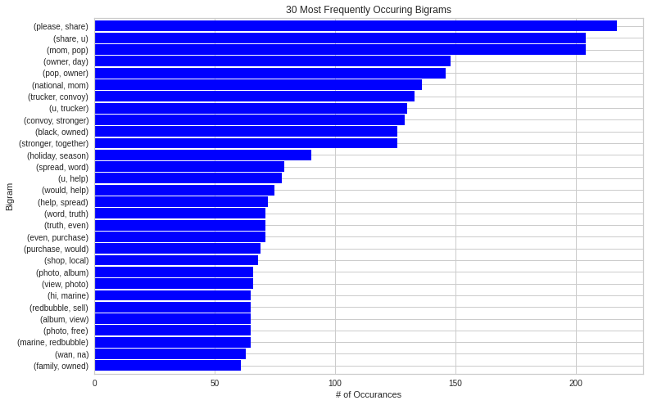

Slide 26
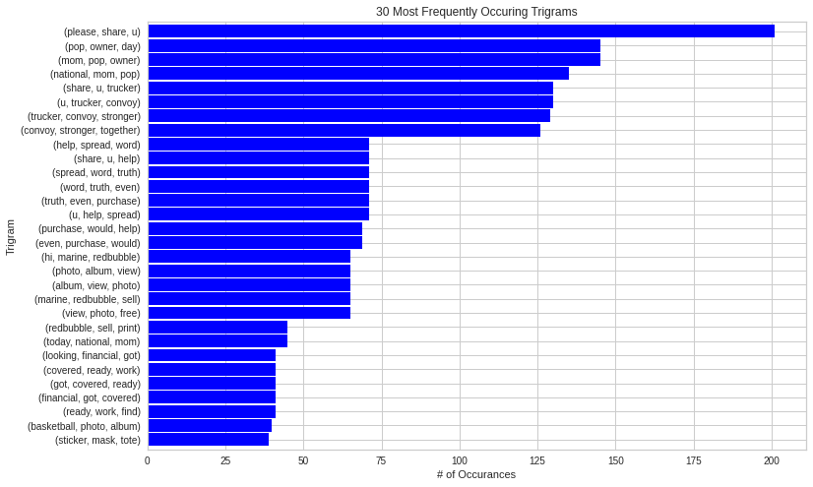

Slide 27
LDA (Latent Dirichlet Allocation)
LDA is a topic modeling technique which we used to extract most talked about topics.
Here we used n-grams that were used to get relevant results.
We observed trigrams and bigrams better results as higher n values give more context
However, four-grams did not perform increase relevance and was time-intensive

Slide 28
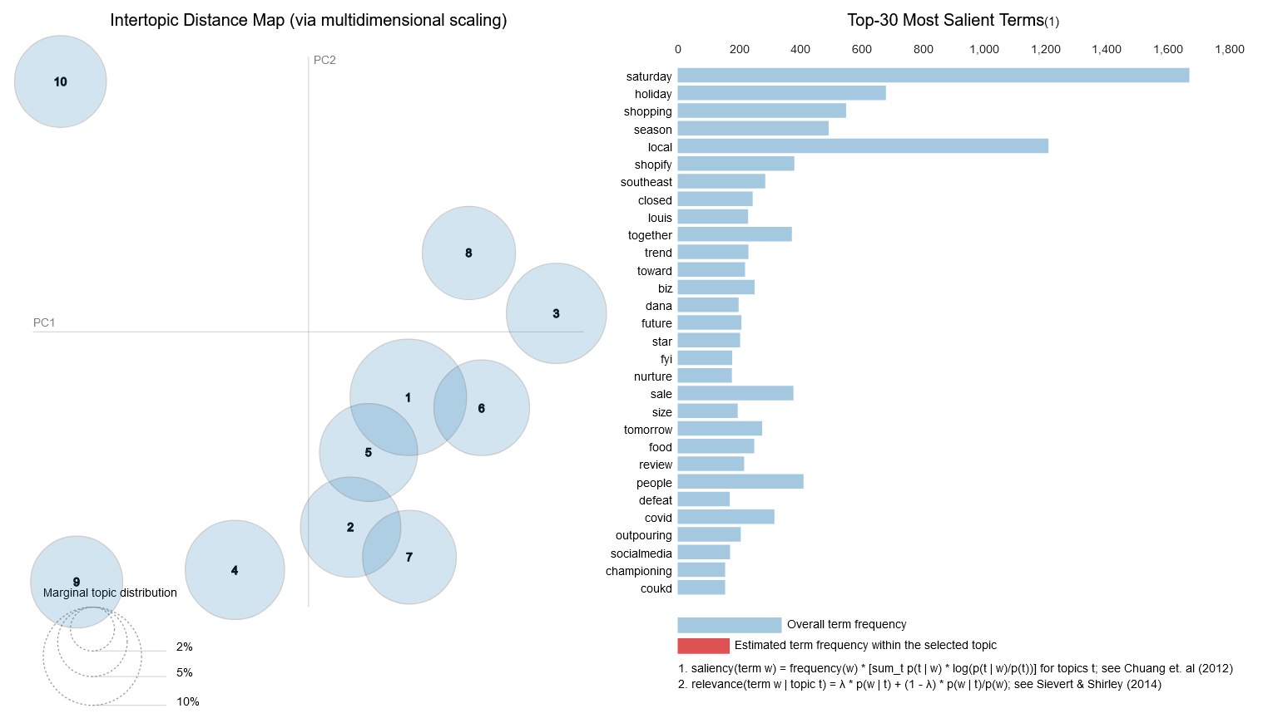
LDA (Latent Dirichlet Allocation) - unigrams

Slide 29
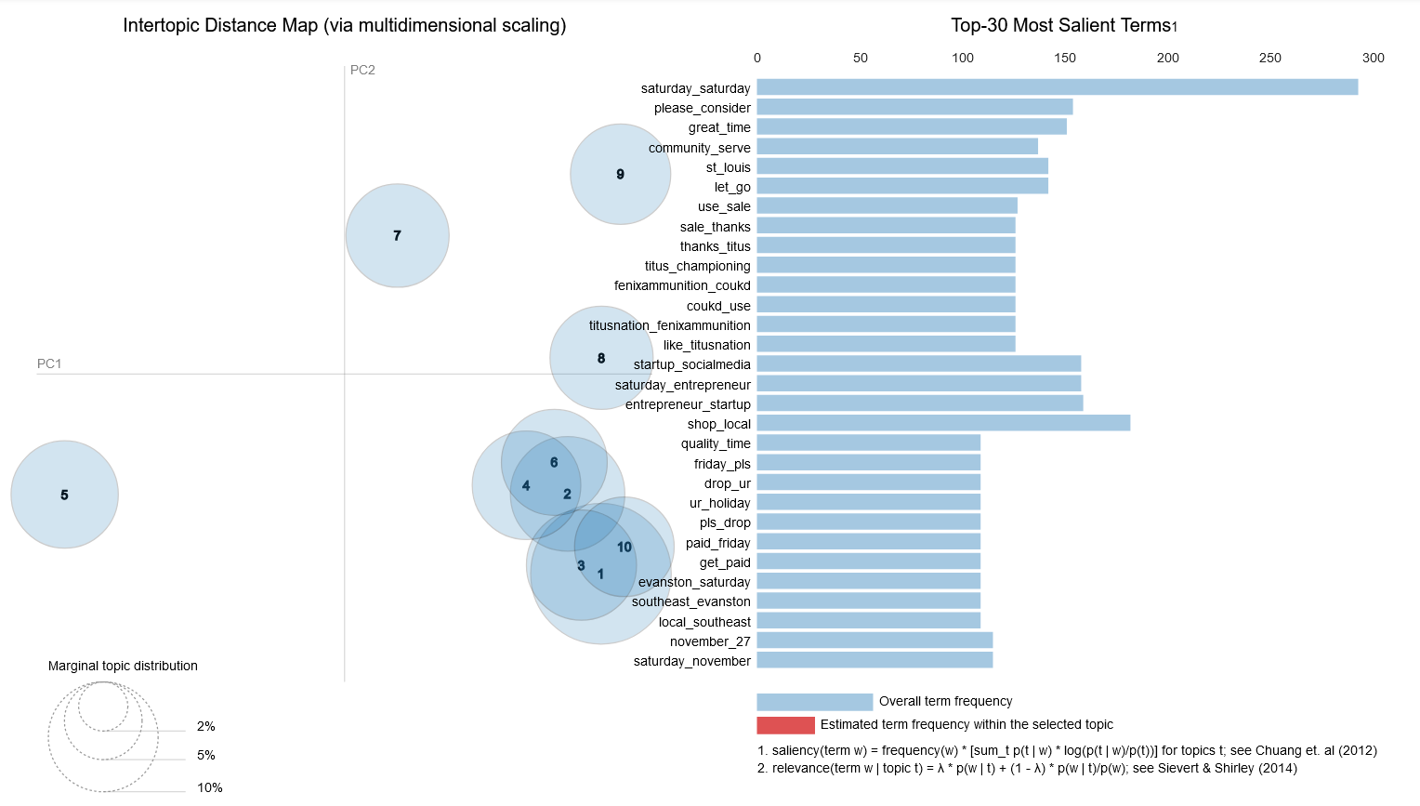
LDA (Latent Dirichlet Allocation) - bigrams

Slide 30
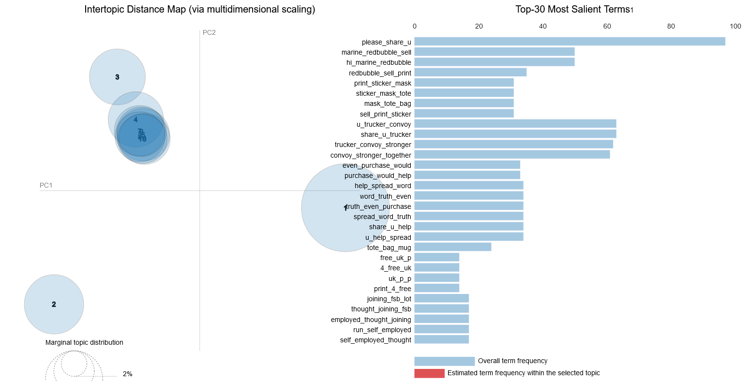
LDA (Latent Dirichlet Allocation) - trigrams

Slide 31
Motivation
Where do we get the Data?
Data Cleaning and Transformation
Technical Challenges
Sentiment Analysis
Exploratory Data Analysis
Results
Conclusion
Next Steps

Slide 32
Results
Overall Sentiment
Sentiment across Locations
Sentiment across Time
Sentiment across Locations and Time

Slide 33
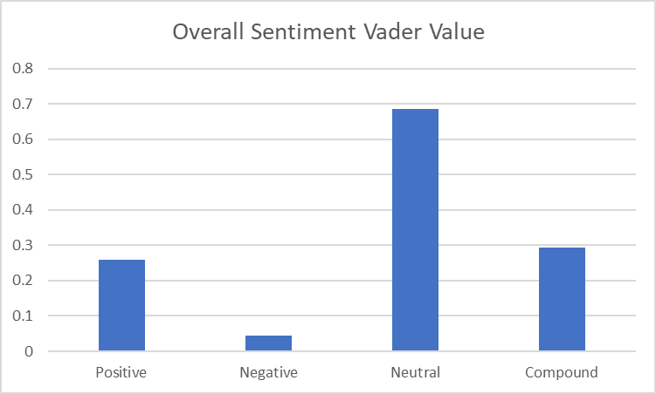
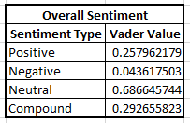
Overall Sentiment

Slide 34
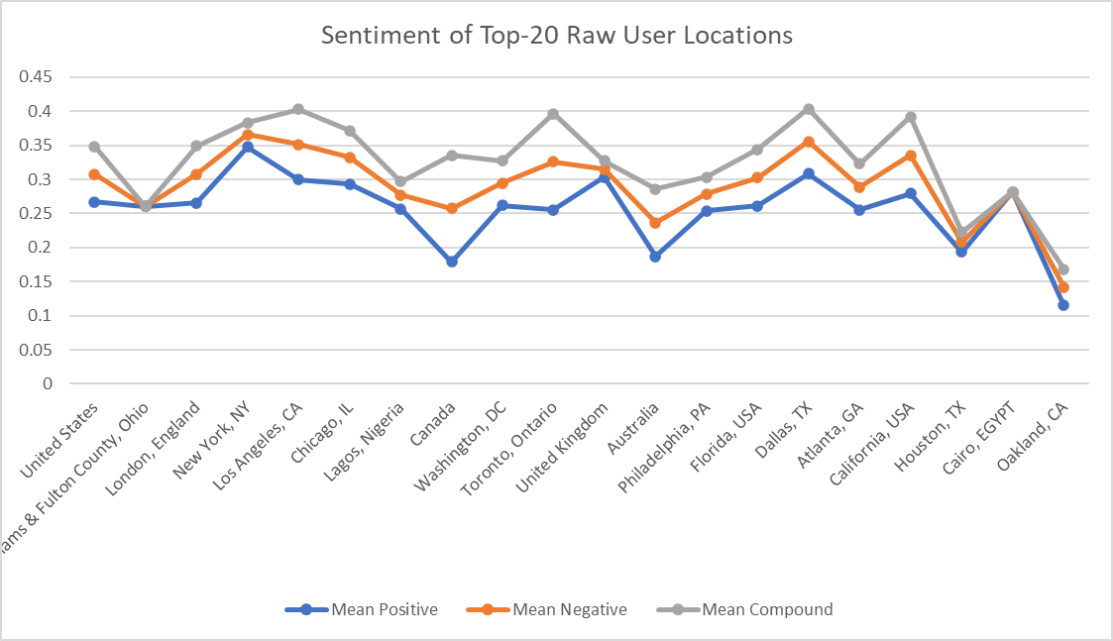
Sentiment across Locations

Slide 35
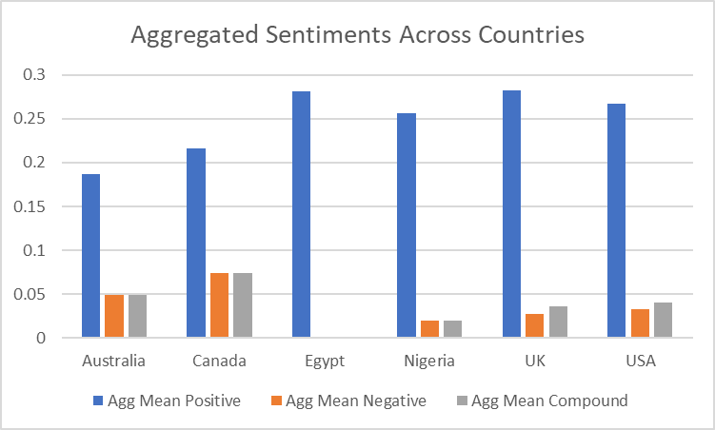
Sentiment across Locations
Some Speculative Comments :
Maybe Egypt and Nigeria are amazing places to be an entrepreneur
UK>USA>Australia ~ Canada
USA has a better overall sentiment than Canada towards SMB
Notes:
Some Speculative Comments :
Maybe Egypt is amazing place to be an entrepreneur
UK>USA>Australia = Canada
USA has a better overall sentiment than Canada towards

Slide 36
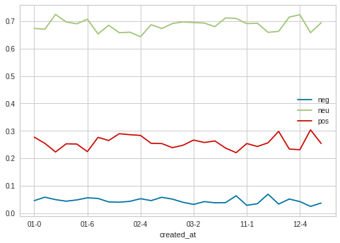
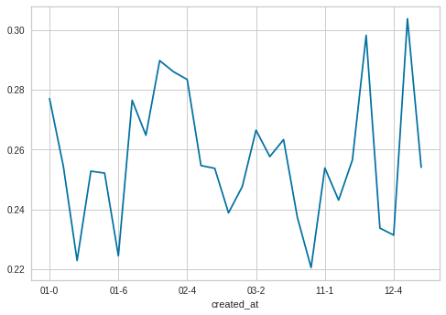
Sentiment across Time
Overall Sentiment mostly positive towards SMB across time
Slight movement towards more positive and less negative in time

Slide 37
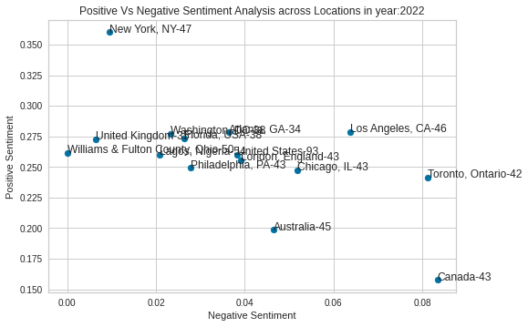
Sentiment across Locations and Time

Slide 38
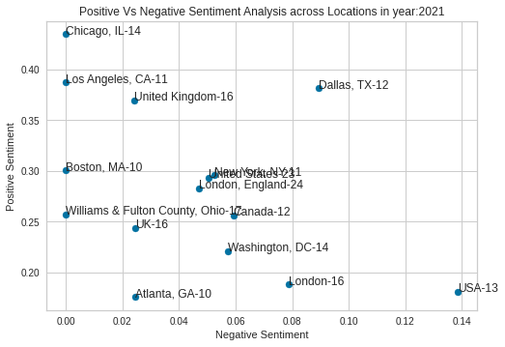
Sentiment across Locations and Time
Notes:
NY Fell and UK improved over time

Slide 39
Motivation
Where do we get the Data?
Data Cleaning and Transformation
Technical Challenges
Sentiment Analysis
Exploratory Data Analysis
Results
Conclusion
Next Steps

Slide 40
Conclusion
As discussed earlier we can see there was an improved positive sentiment during covid towards Small Businesses
We’re able to see different locations having different sentiments/opinions on small businesses
Unexpected Results: Egypt and Nigeria have shown immense support to Small Businesses
Speculation : for the latest data we can see that UK has good place for SMB

Slide 41
Motivation
Where do we get the Data?
Data Cleaning and Transformation
Technical Challenges
Sentiment Analysis
Exploratory Data Analysis
Results
Conclusion
Next Steps

Slide 42
Next Steps
More Data: We plan to extract even more data and perform better location clustering to get even more insights about the data
Improved Location Mapping : Current flaw in processing location needs fix
Improved Clustering : As of now, we have tried LDA (n-grams) and initial NMF clustering techniques. We plan to dig deeper in the clustering techniques to get a better overview about the topics and capture more relevance from the data
External Data Sources : We plan to merge the current tweet data with the data related to the Covid waves and see further trends explained by them
Publish Research : Conversations on this space are new (try INFORMS Confs.)

Slide 43
Thank you!
Happy to connect :)
Davidson Siga
dsiga@cmu.edu
linkedin.com/in/davidsonsiga
MISM 16, CMU
Rajanikant Tenguria
trajanikant@cmu.edu
linkedin.com/in/algorrt
MISM 12, CMU

Slide 44
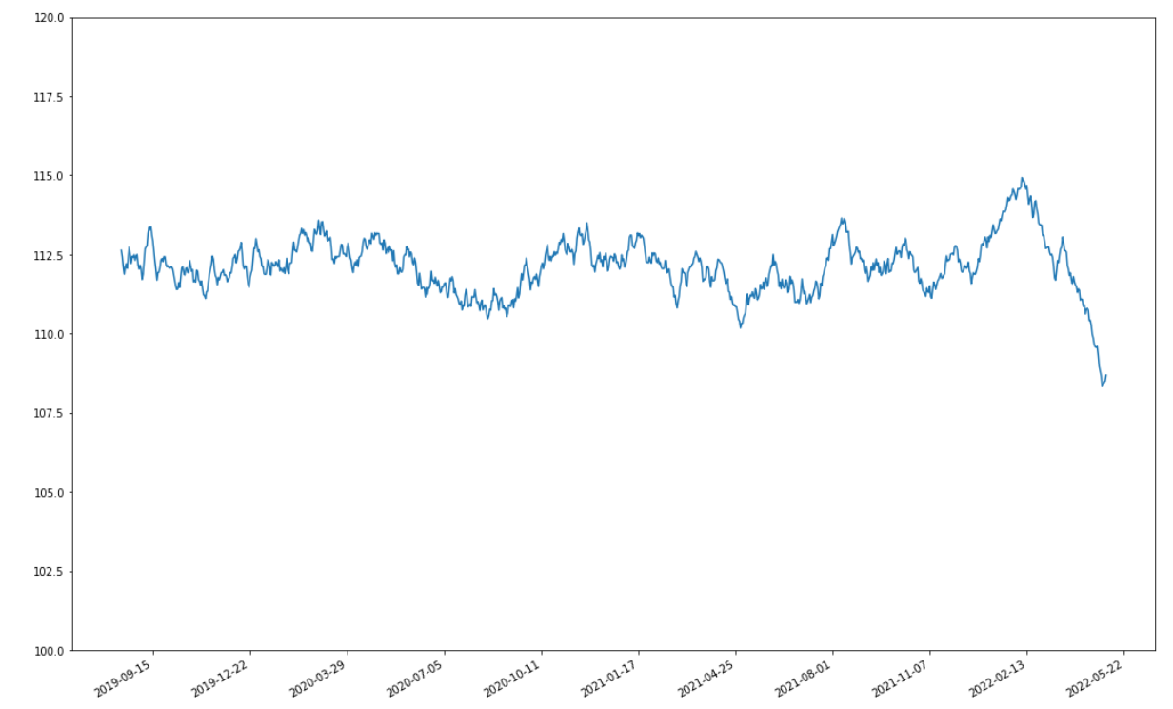
Data across time

